Slide 1

CND
Analog Project
Ring Oscillator
Submitted by: Nada, Fagr and Mohamed

Slide 2

Intro
Fagr Ahmed
Nada Waleed
Mohamed Yasser

Slide 3
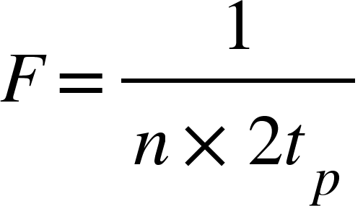
3 stage ring Oscillator
Using this equation to control the frequency of the oscillator by modifying the capacitive load to increase or decrease the frequency while maintaining the vdd at 1V. The delay of the inverter was calculated using cadence. Where n is the number of stages and tp is the propagation delay.

Slide 4
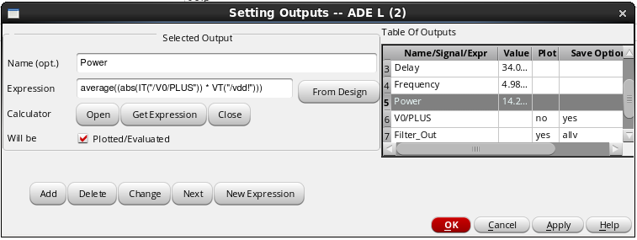
Power Calculation

Slide 5
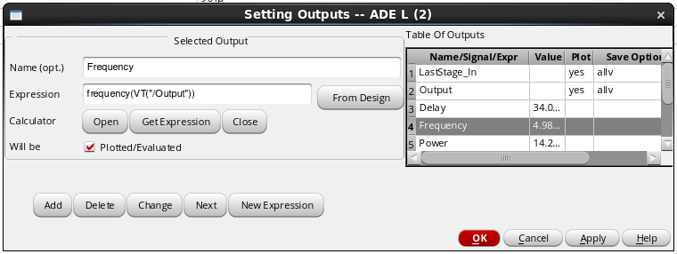
Frequency Calculation

Slide 6
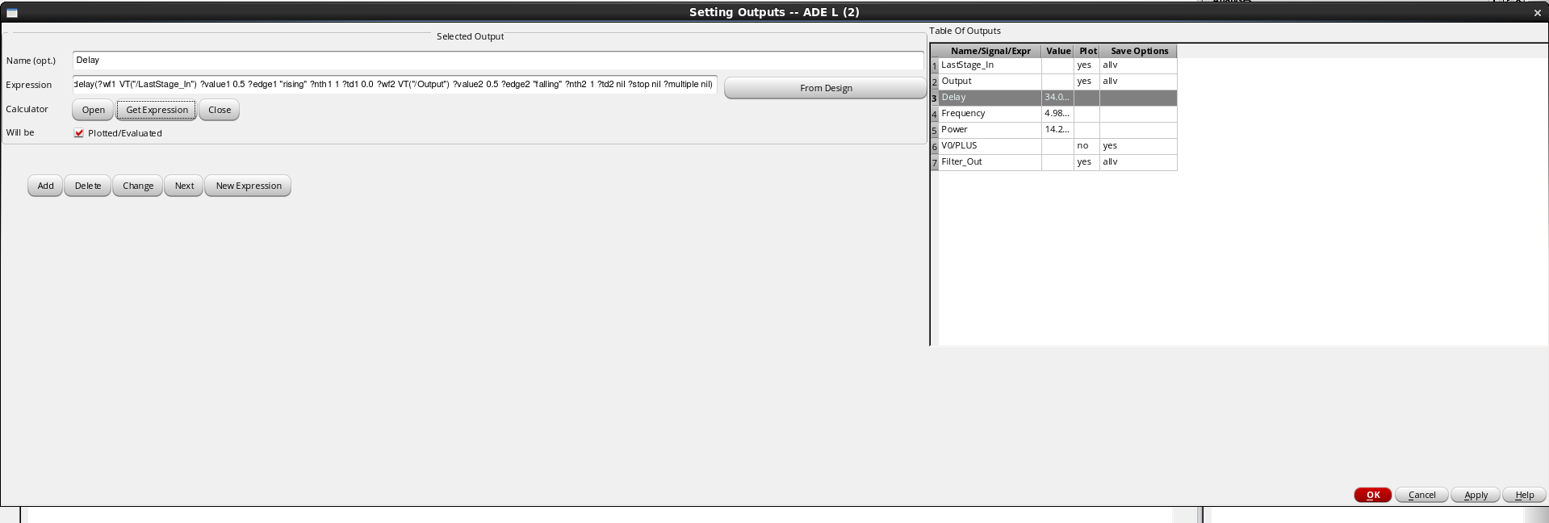
Delay Calculation

Slide 7
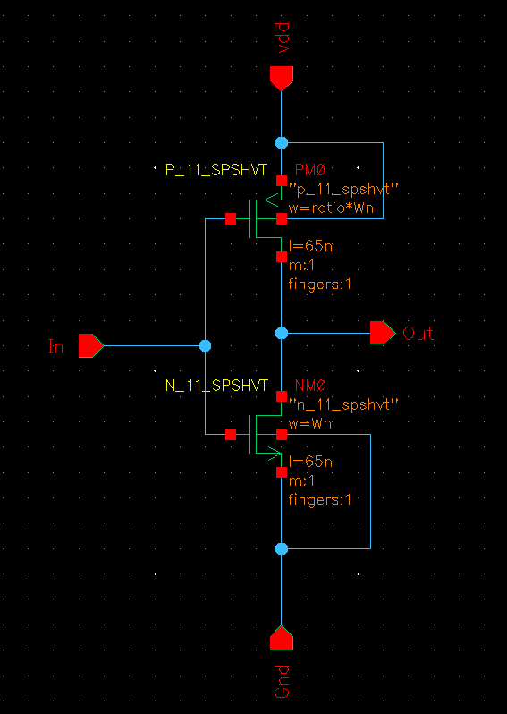
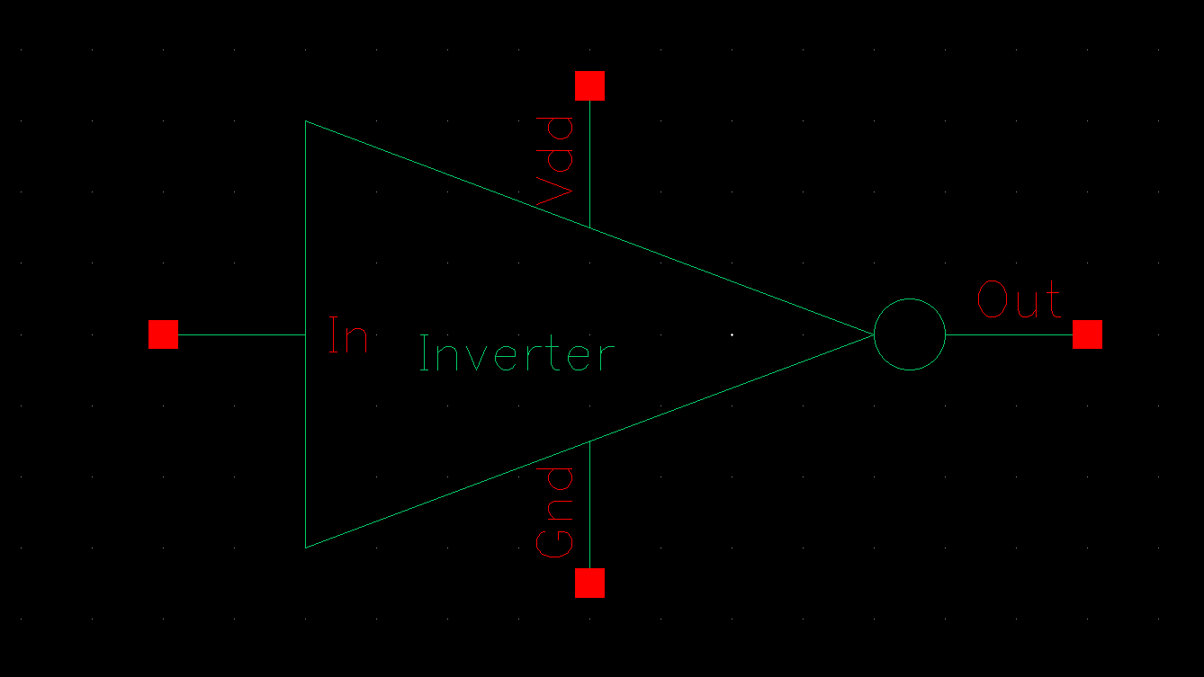
3 stage ring Oscillator
The Schematic of the inverter:
The Symbol of the inverter:

Slide 8
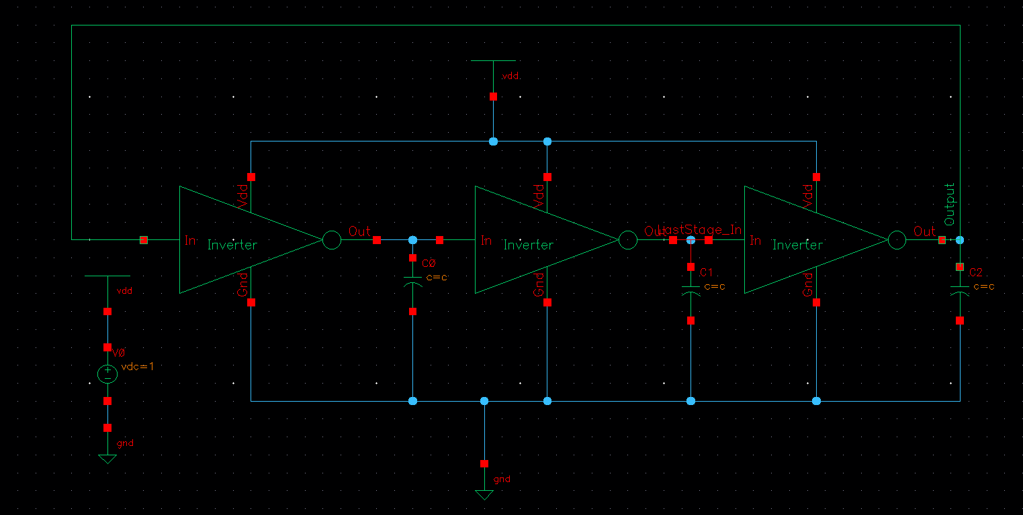
3 stage ring Oscillator
The Schematic of the Oscillator:

Slide 9
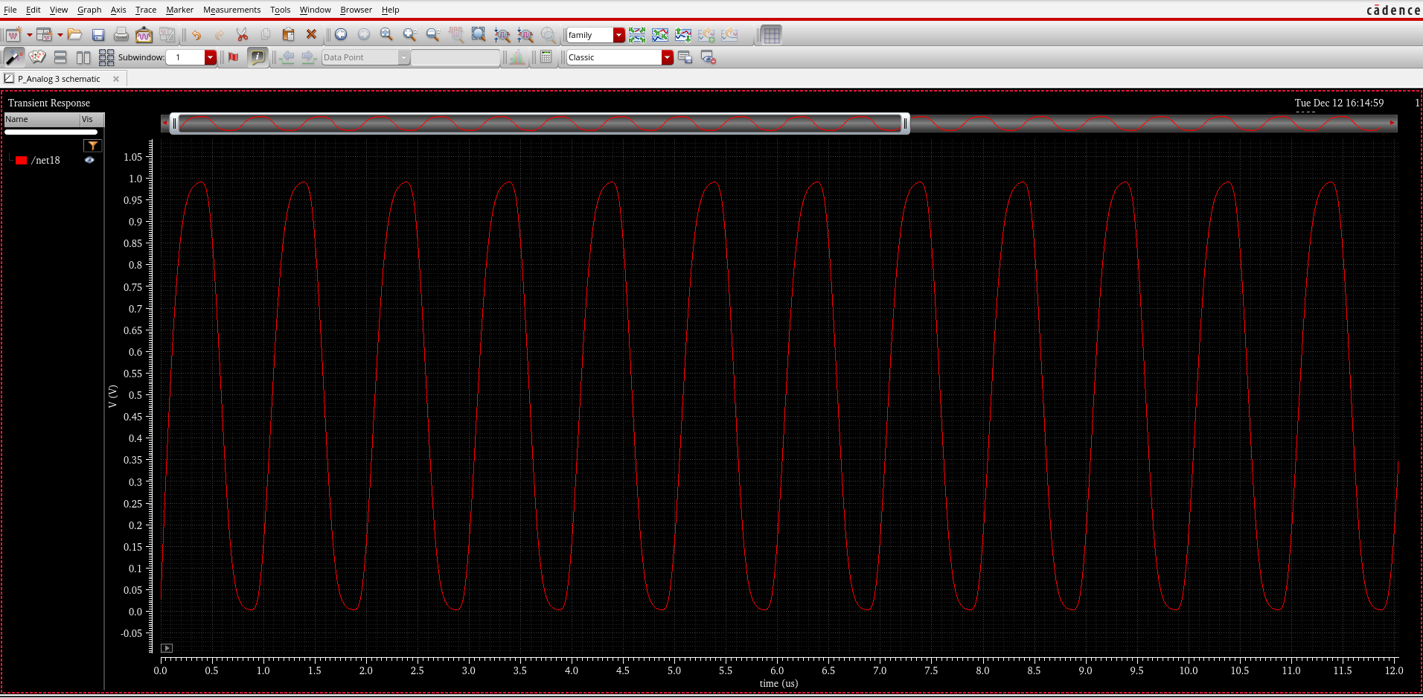
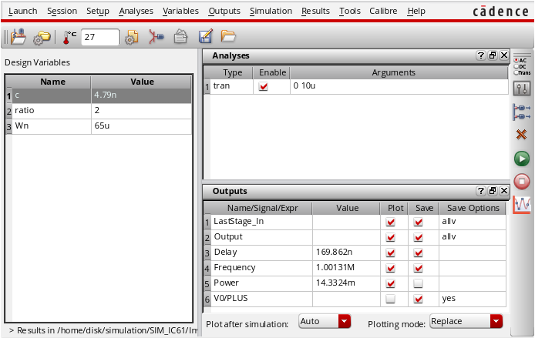
1MHz Case
The Wave output:
ADE L Calculated Results:

Slide 10
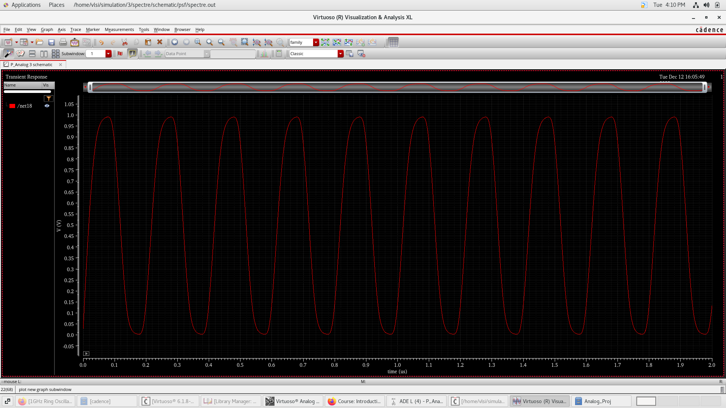
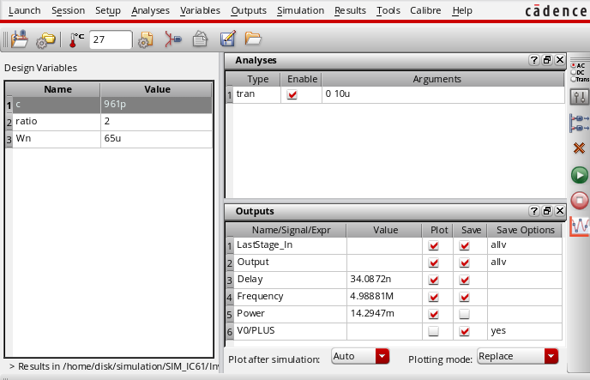
5MHz Case
The Wave output:
ADE L Calculated Results:

Slide 11
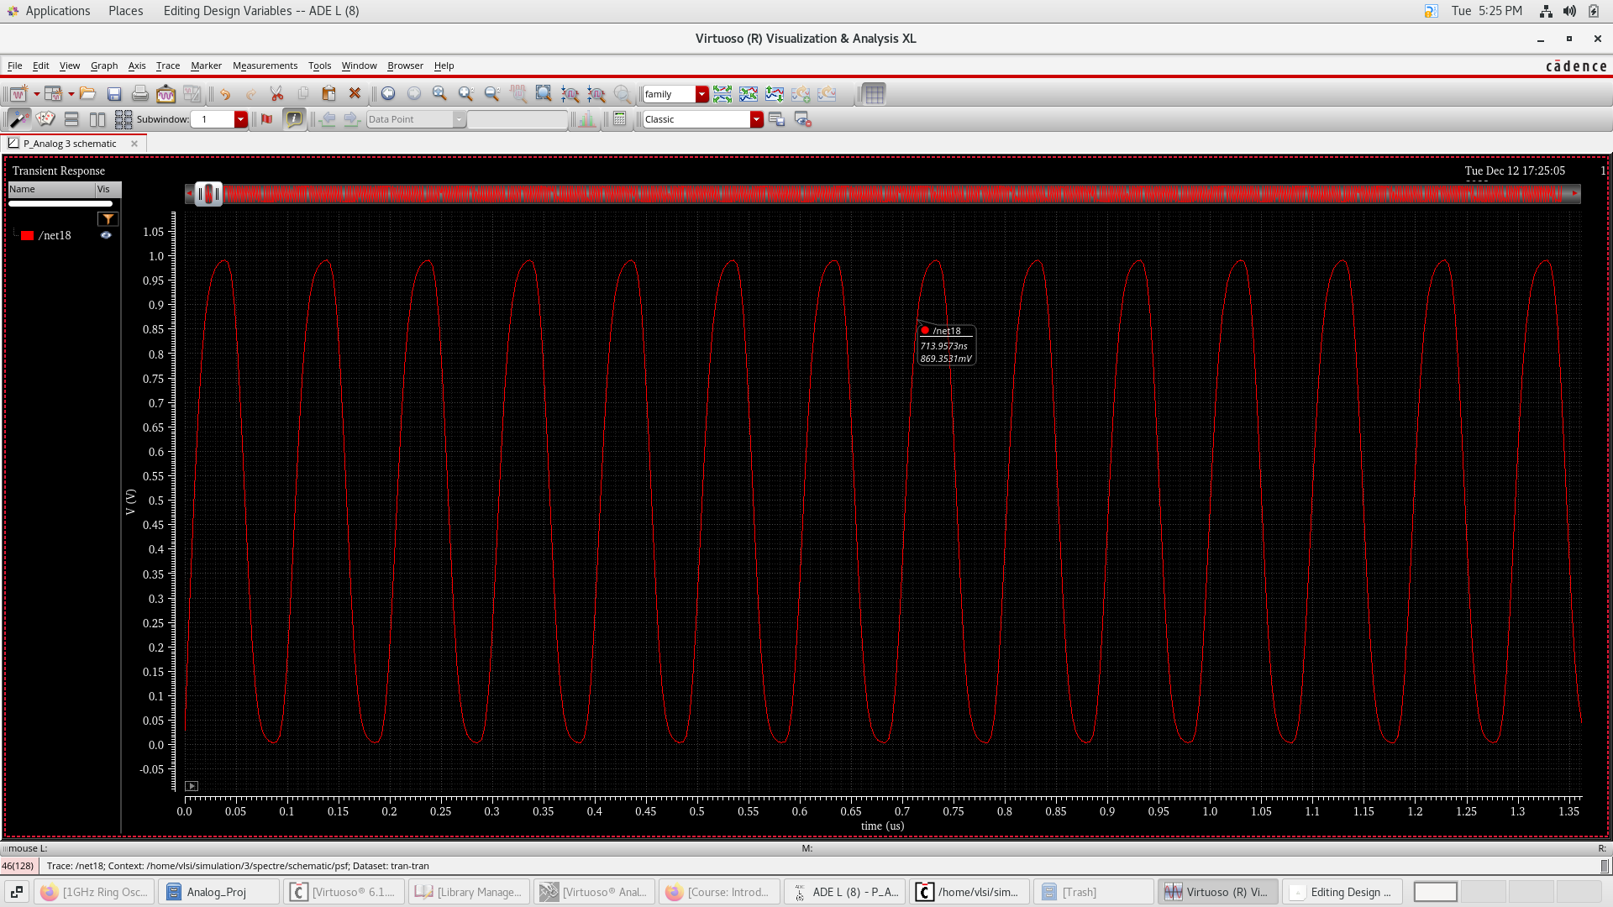
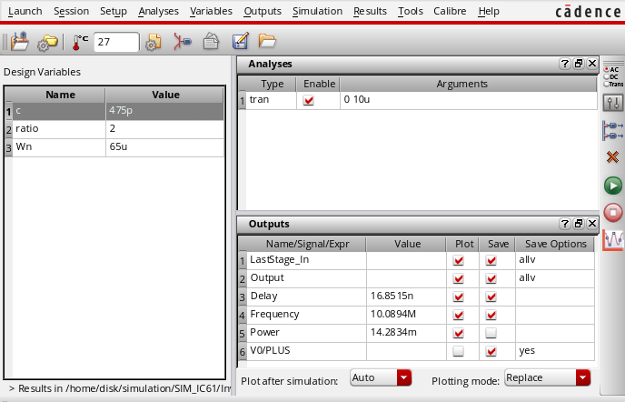
10MHz Case
The Wave output:
ADE L Calculated Results:

Slide 12
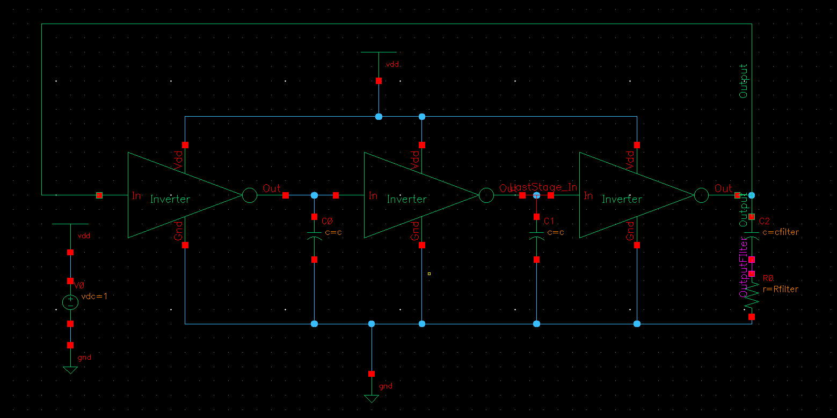
5MHz with a high pass Filter
The Schematic:

Slide 13
5MHz with a high pass Filter
The Wave output:
ADE L Calculated Results:

Slide 14
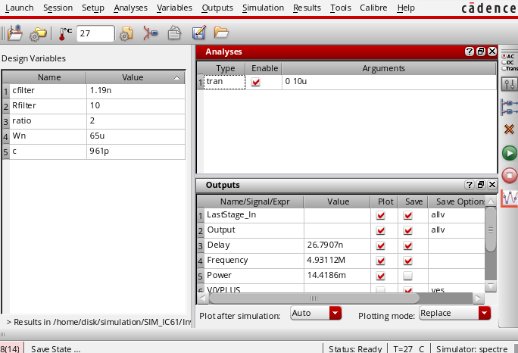
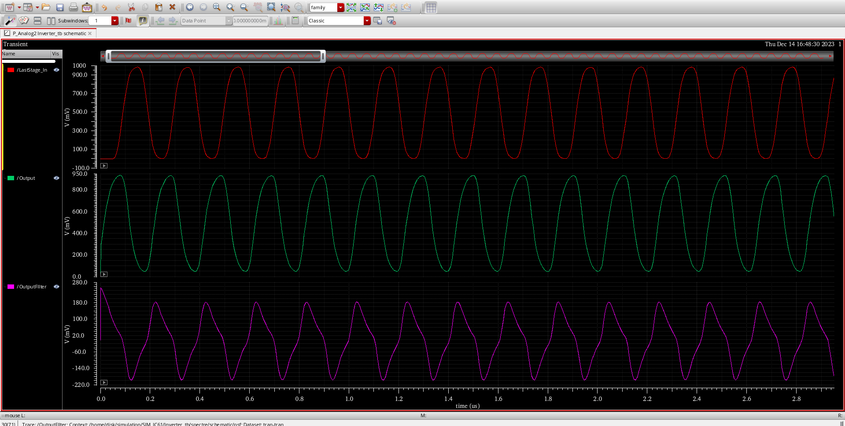
5MHz with a high pass Filter
The ADEL Results:
The Wave Results:

Slide 15

Thanks!

